Slide 1


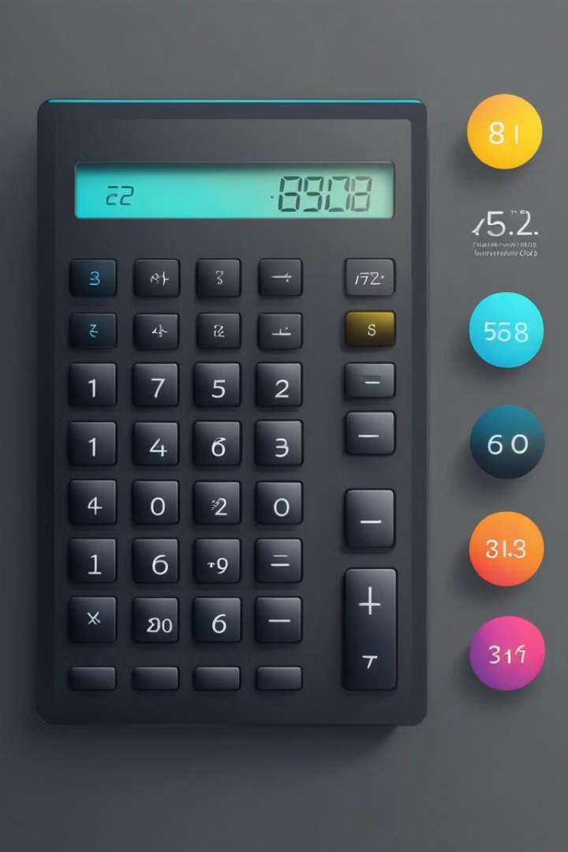

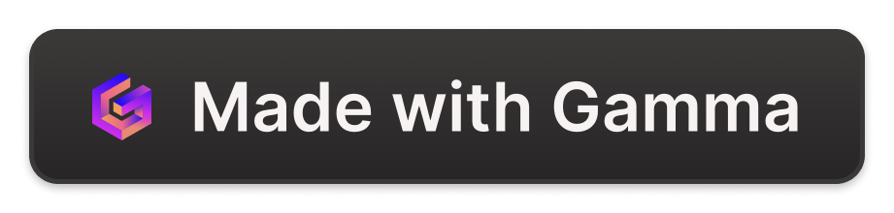
Project 1 – Calculator Using Tkinter Project
Introduction to Tkinter
The calculator project using Tkinter is an exciting opportunity to delve into the world of GUI programming with Python. This project aims to create a user-friendly calculator application with a graphical interface, providing an intuitive experience for performing basic arithmetic operations.
Tkinter is a popular Python library for creating GUI applications.
by Deepu Chopra
Institute Name - Digichrome Academy
Da
By: Deepu Chopra

Slide 2
Overview of calculator project
Functionality
User Interface
Display
The calculator will perform basic arithmetic operations like addition, subtraction, multiplication, and division.
The user interface will include clear, intuitive buttons for numbers, mathematical operations, and special functions.
The calculator will have a digital display to show the input and results of the calculations in a clear and organized manner.

Slide 3
Setting up the tkinter window
Initial Setup
Layout Management
Event Loop
Create the main tkinter window by importing the tkinter module and initializing it. Set the window's title, size, and any other initial configurations.
Define the layout of the window using geometry managers like Grid, Pack, or Place. This will determine the positioning and sizing of elements within the window.
Start the event loop, which listens for events such as button clicks, key presses, or window resizing. This keeps the tkinter window interactive and responsive.

Slide 4
Setting up the tkinter window
Initial Setup
Layout Management
Event Loop
Create the main tkinter window by importing the tkinter module and initializing it. Set the window's title, size, and any other initial configurations.
Define the layout of the window using geometry managers like Grid, Pack, or Place. This will determine the positioning and sizing of elements within the window.
Start the event loop, which listens for events such as button clicks, key presses, or window resizing. This keeps the tkinter window interactive and responsive.

Slide 5
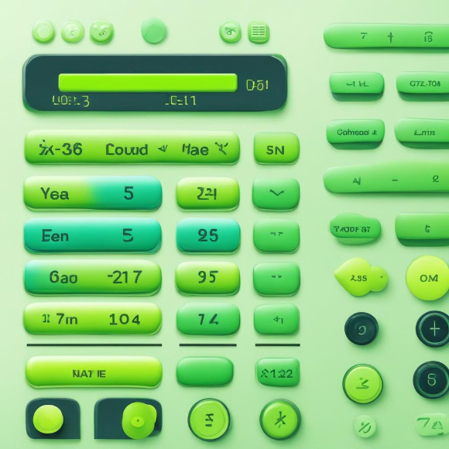
Creating buttons and labels
When creating a calculator interface, it's essential to design clear and responsive buttons for user input. Labels play a crucial role in displaying numbers and the ongoing operations.

Slide 6

Handling button clicks
Click event: When a button is clicked, it triggers a specific function
Button identification: Each button is assigned a unique ID for handling
Conditional operations: Buttons are linked to conditional statements based on user input

Slide 7
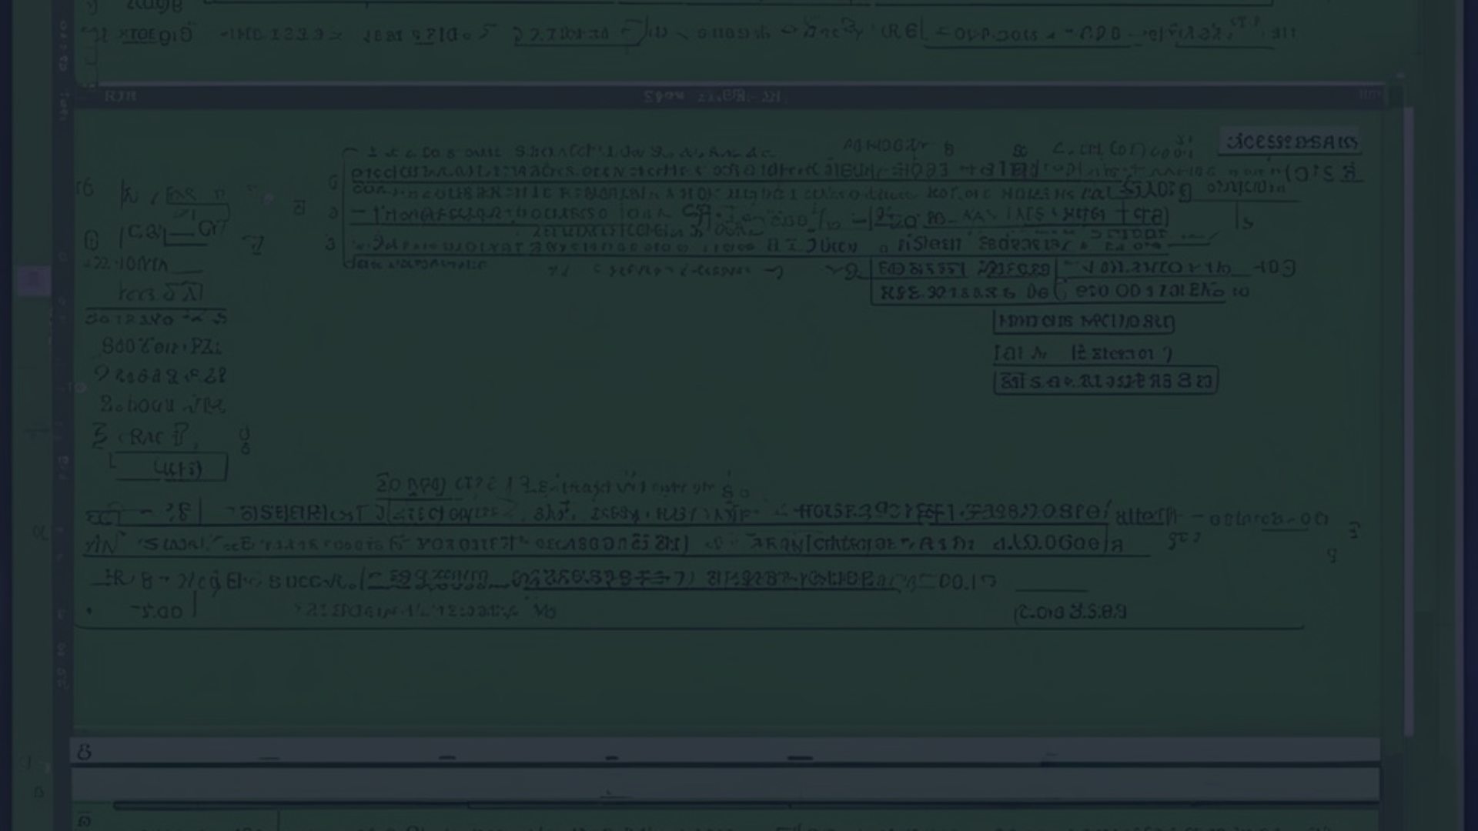



Implementing basic arithmetic operations
Addition
Subtraction
Multiplication & Division
Implement the functionality to add two numbers together.
Enable the system to subtract one number from another.
Extend the calculator to handle multiplication and division operations.

Slide 8

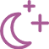
Adding functionality for decimal point and clear button
Decimal Point
Clear Button
It allows users to input decimal numbers for precise calculations.
Enables users to clear the input or reset the calculator.

Slide 9
Displaying the result
Result label
1
Visible area for displaying the result
Formatted output
2
Styling to ensure clear readability
Dynamic update
3
Real-time display of calculation results

Slide 10
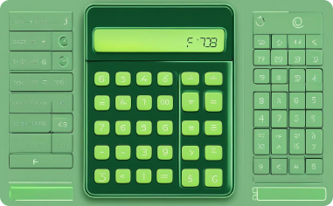
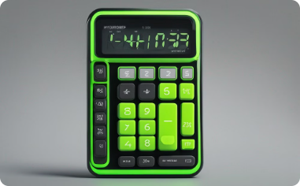
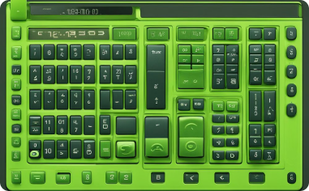
Styling the calculator
Modern and Sleek Design
Customizable Themes
Sophisticated User Interface
The calculator features a modern, minimalistic design with a sleek and elegant button layout, designed to enhance user experience.
Users can personalize the calculator with customizable themes, vibrant color schemes, and user-friendly controls for a personalized touch.
The calculator sports a sophisticated user interface, including a high-resolution display, adjustable font sizes, and an intuitive layout for ease of use.

Slide 11
Conclusion and Next Steps
As we wrap up, it's exciting to see the progress made in creating a calculator using tkinter. The next steps involve refining the user interface and adding advanced functionalities like memory storage and scientific calculations.
Exploring other tkinter projects and diving into more complex GUI applications would be a great way to further enhance your Python programming skills.

Slide 12
